Slide 1
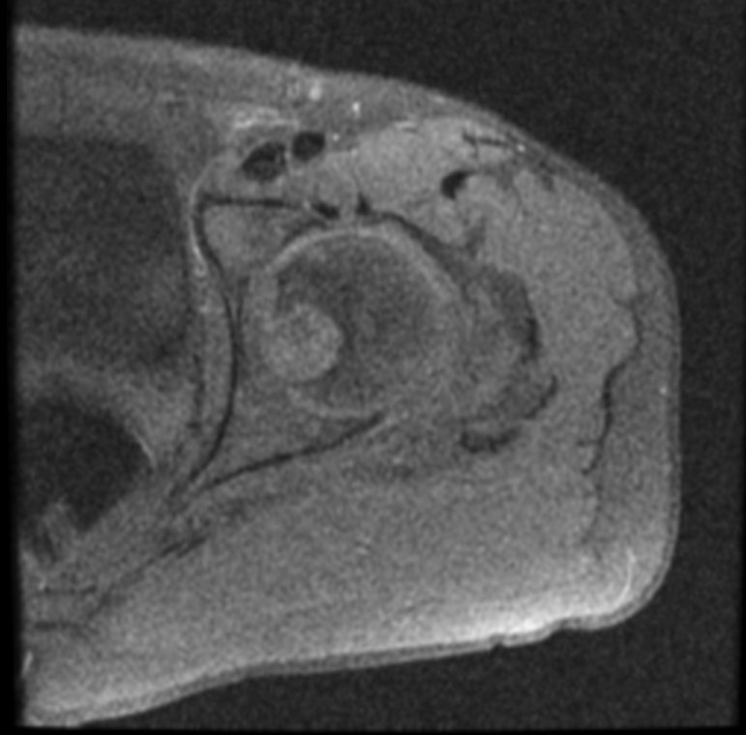
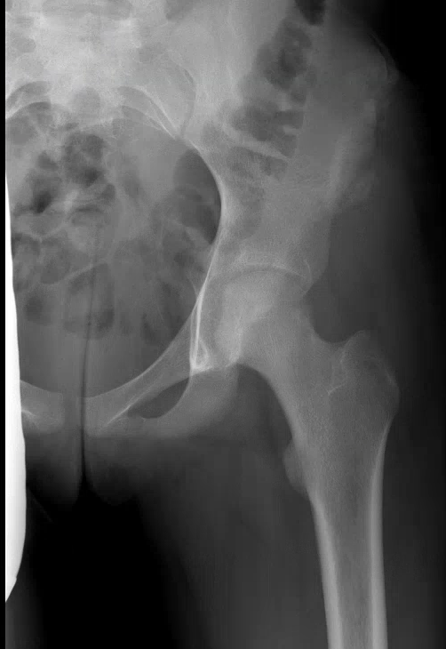
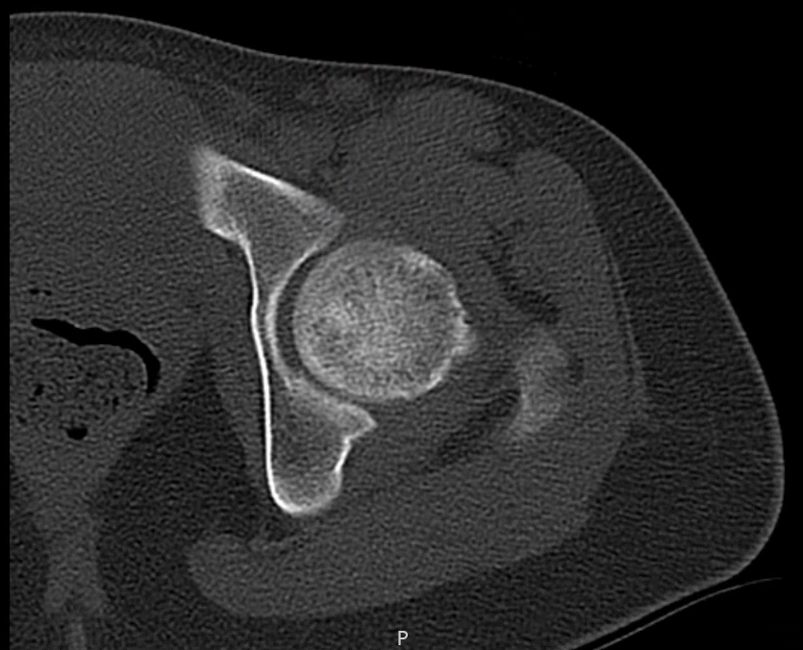
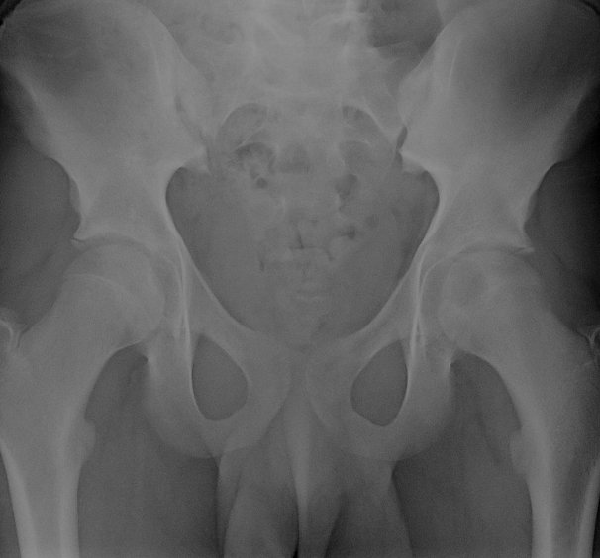
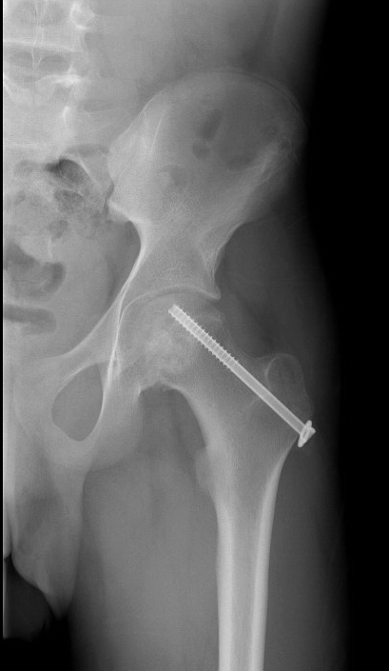
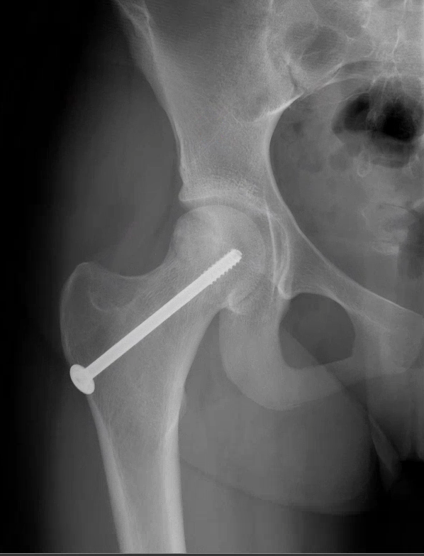
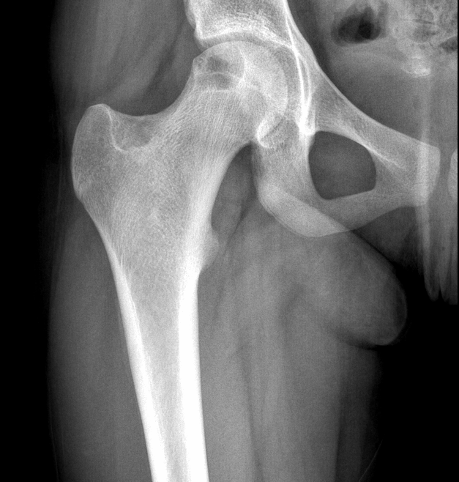
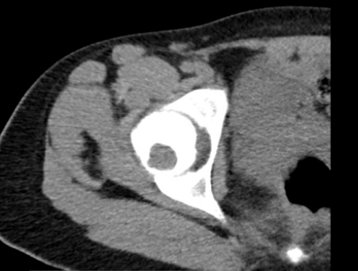
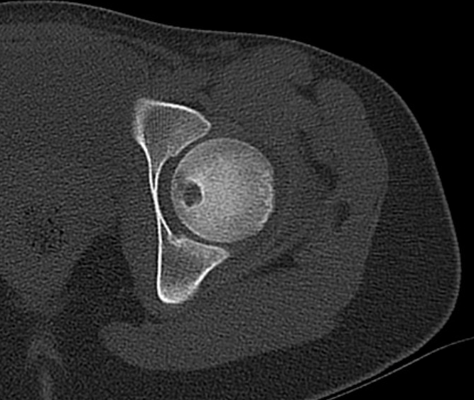
Chondroblastoma of the Femoral Head: Presentation, Surgical Excision, and Complications
Tyler Hoskins, B.S.¹, Laura Sonnylal, B.S.¹, James C. Wittig, M.D. ¹
¹John Theurer Cancer Center, Hackensack University Medical Center
Background
B
Chondroblastoma is a benign, locally aggressive tumor typically arising in the epiphysis of bone. The diagnosis is rare and only makes up 1-2% of all bone tumors. Chondroblastoma usually affects children and young adults (95% 5-25 years old) and has a male predilection (2:1). It is most commonly found in the long bones (femur, tibia, humerus). The most common clinical symptom is gradually worsening mild to severe pain. Chondroblastoma is often misdiagnosed as a sports injury. Radiographically, chondroblastoma presents as a well-circumscribed geographic defect surrounded by a rim of sclerotic bone. Chondroblastoma has a high propensity for local recurrence and in very rare cases can metastasize to the lung. The most common treatment is intralesional curettage resection with bone grafting. Additional/adjuvant treatments include substitution of polymethylmethacrylate (PMMA) for the bone graft, electric or chemical cauterization, and cryosurgery which are often used to decrease risk of local recurrence. CT guided radiofrequency ablation has also been successful in the treatment of very selected small tumors (minimally invasive approach).
2Α
4A
4Β
Purpose
Figure 4. AP X-ray (4A) and axial CT scan (4B) of patient 1, 6 months and 10 months respectively, after resection of the chondroblastoma and bone grafting. The osseous structures appear within normal limits and the overlying soft tissues are unremarkable.
The purpose of this study is to report the clinical, radiographic, and pathological presentation as well as the results of surgical excision, cryosurgery and bone grafting of three patients treated by the principal investigator between 2014-2017 for chondroblastoma of the femoral head.
Patients & Methods
Two females and one male were treated by the principal investigator between 2014-2017 for chondroblastoma of the femoral head. The average age of the patients was 14.3 years old (14-15 years old). Two patients were originally misdiagnosed with sports injuries. Patients 1 and 3 were treated with curettage resection, adjuvant electrocauterization, and iliac crest bone grafting. Patient 2 was treated with curettage resection, adjuvant electrocauterization, cryosurgery, iliac crest bone grafting, and bone/cartilage allografting. Patient 2 and 3 were also treated with a cannulated screw for prophylactic fixation. Functional outcome was assessed by the Musculoskeletal Tumor Society (MSTS) scoring system. Recurrence was assessed radiologically at each follow up visit. The mean follow-up period for these patients is 16 months (14-18 months).
2Β
Figure 2. Axial MRI (2A) and AP X-ray (2B) of left hip showing chondroblastoma of left femoral head (Patient 2). Lesion measures 2.0 cm AP x 1.8 cm transverse x 2.0 cm craniocaudal.
5Α
5B
Patient | Age | Size of Lesion | Surgery Performed
1 | 14 | 1.54 cm³ | Curettage resection of left femoral head, iliac crest bone graft.
2 | 14 | 7.20 cm³ | Curettage resection of left femoral head, cryosurgery, iliac crest bone graft, bone and cartilage allograft, and fixation.
3 | 15 | 6.08 cm³ | Curettage resection of right femoral head, iliac crest bone graft, and fixation.
Figure 5. Three month post-operative AP X-ray (5A) of patient 2 reveals heterogeneity along the left anterior superior iliac crest, but this is compatible with a bone graft harvesting site. There is no evidence of tumor recurrence and the bone graft appears to have incorporated. The femoral head is spherical. A 10 month post-operative AP X-ray (5B) on patient 3 reveals a tight irregularity along the cortical margin on the AP projection of the right proximal femoral head. The bone graft appears to have incorporated. There is no recurrence and the femoral head is spherical. A cannulated screw is also seen traversing the greater trochanter of each femur for prophylactic fixation.
Table 1. Patients treated by the principal investigator. The mean age was 14.3 and the mean size of each lesion was 4.94 cm³.
3A
3B
Conclusions
Figure 3. AP X-ray (3A) and axial CT scan (3B) of right hip showing chondroblastoma within the posterolateral aspect of the right femoral head (Patient 3). Lesion measures 2.0 cm AP x 1.6 cm transverse x 1.9 cm craniocaudal.
Due to the aggressive nature of a chondroblastoma, it is important to establish a proper diagnosis as early as possible to prevent significant local bone destruction and potential loss of a mobile hip. Chondroblastomas are benign aggressive tumors with a propensity for local recurrence. Adjuvants should be considered in their treatment to reduce the risks of recurrence. Attention to detail and proper fixation as well as following a strict non weight bearing protocol after surgery are crucial for preventing collapse of the femoral head and postoperative fracture. Caution is also advised when using cryosurgery. Although this type of procedure may be efficacious for decreasing the risk of local recurrence, it should be reserved for those with sufficient experience with this technique to avoid any complications. It is also important to include chondroblastoma in the differential of sports injuries since two of three patients were misdiagnosed with a sports injury prior to evaluation by an orthopedic oncologist. Limitations in this study include the small patient population and short follow up time. Additional patients and long-term follow up is needed due to the high rates of recurrence for this condition.
Results
The mean MSTS functional score at the last follow up was 23 (21-25). All patients are alive, pain-free, and there have been no recurrences. There have also been no incidences of infection, avascular necrosis, or collapse of femoral head. In addition, all femoral heads remained spherical, range of motion of hips at follow-up visits was normal, and patients have returned to pre-operative function; participating fully in sports. However, patient 1 has experienced an enlarged inguinal lymph node 25 months after surgery, which has been confirmed as reactive.
Figure 1. Axial CT scan of left hip showing chondroblastoma of left femoral head (Patient 1). Lesion measures 1.1 cm AP x 1 cm transverse x 1.4 cm craniocaudal.
Contact
References
Damron, T. Chondroblastoma. MedScape. 2014.
Malawer, Martin M., James C. Wittig, and Jacob Bickels. Operative Techniques in Orthopaedic Surgical Oncology. Philadelphia: Wolters Kluwer Health/Lippincott
Williams & Wilkins, 2012. Print.
Mattos, C., Angsanuntsukh, C., Arkader, A., Dormans, J. Chondroblastoma and Chondromyxoid Fibroma. Journal of the American Academy of Orthopedic
Surgeons. 2013. 4: 225-233.
James C. Wittig, M.D.
Hackensack University Medical Center
20 Prospect Avenue, Suite 501
Hackensack, NJ 07601
Email: DrJamesWittig@gmail.com
Phone: (551) 996-2533

